Slide 1
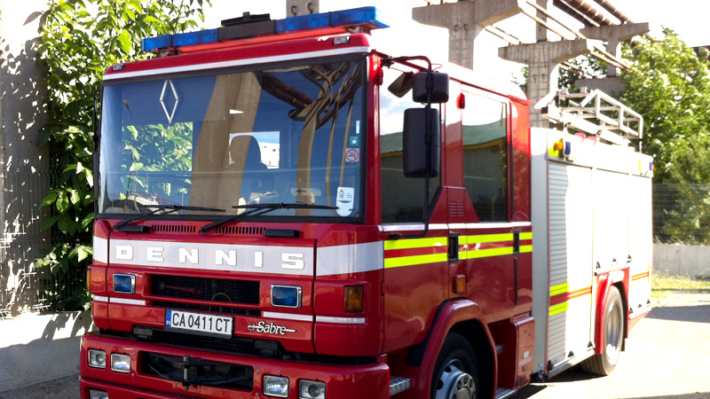
Our project
Created by: The Flame Guardians

Slide 2
About the team
Scrum Trainer-Yoan
Front-end-Dimitar
Back-end-Stefan
Designer-Daniel

Slide 3



Programs and technologies used:

Slide 4
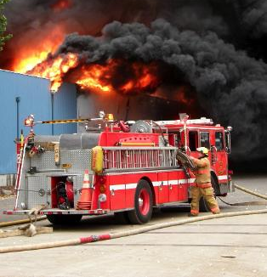
The steps of our work
Role managament
Organization
Reazisation

Slide 5
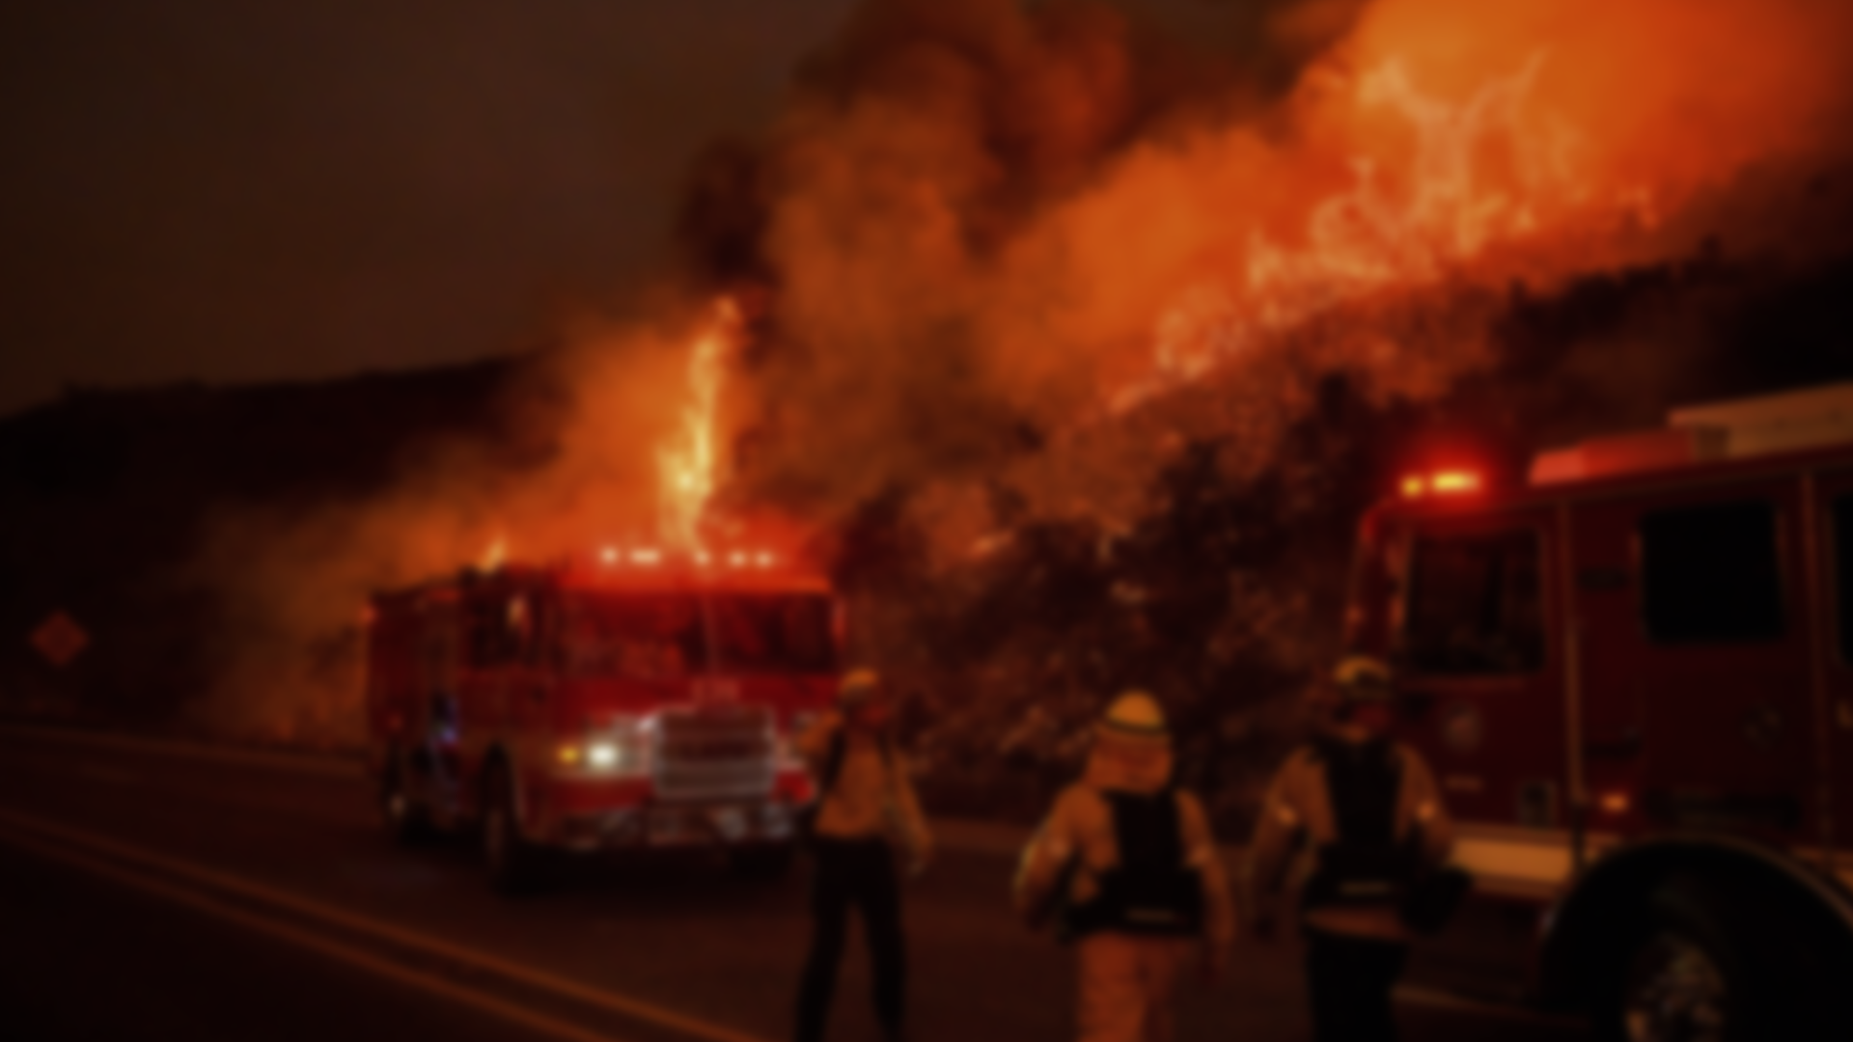
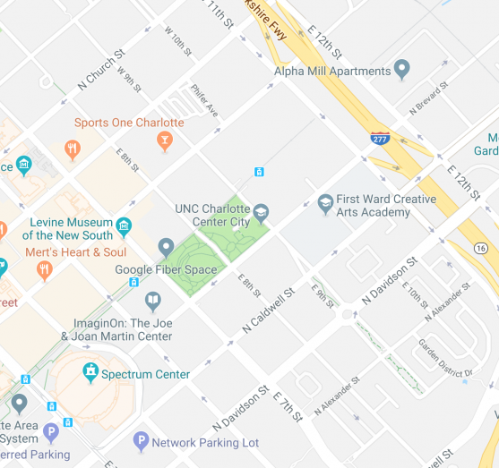
And now let us show you our website
Presentation made by Daniel Kolev

